Slide 1

ecoGo
The guide for those who wish to travel sustainably.
*Work in progress* - Subject to change

Slide 2
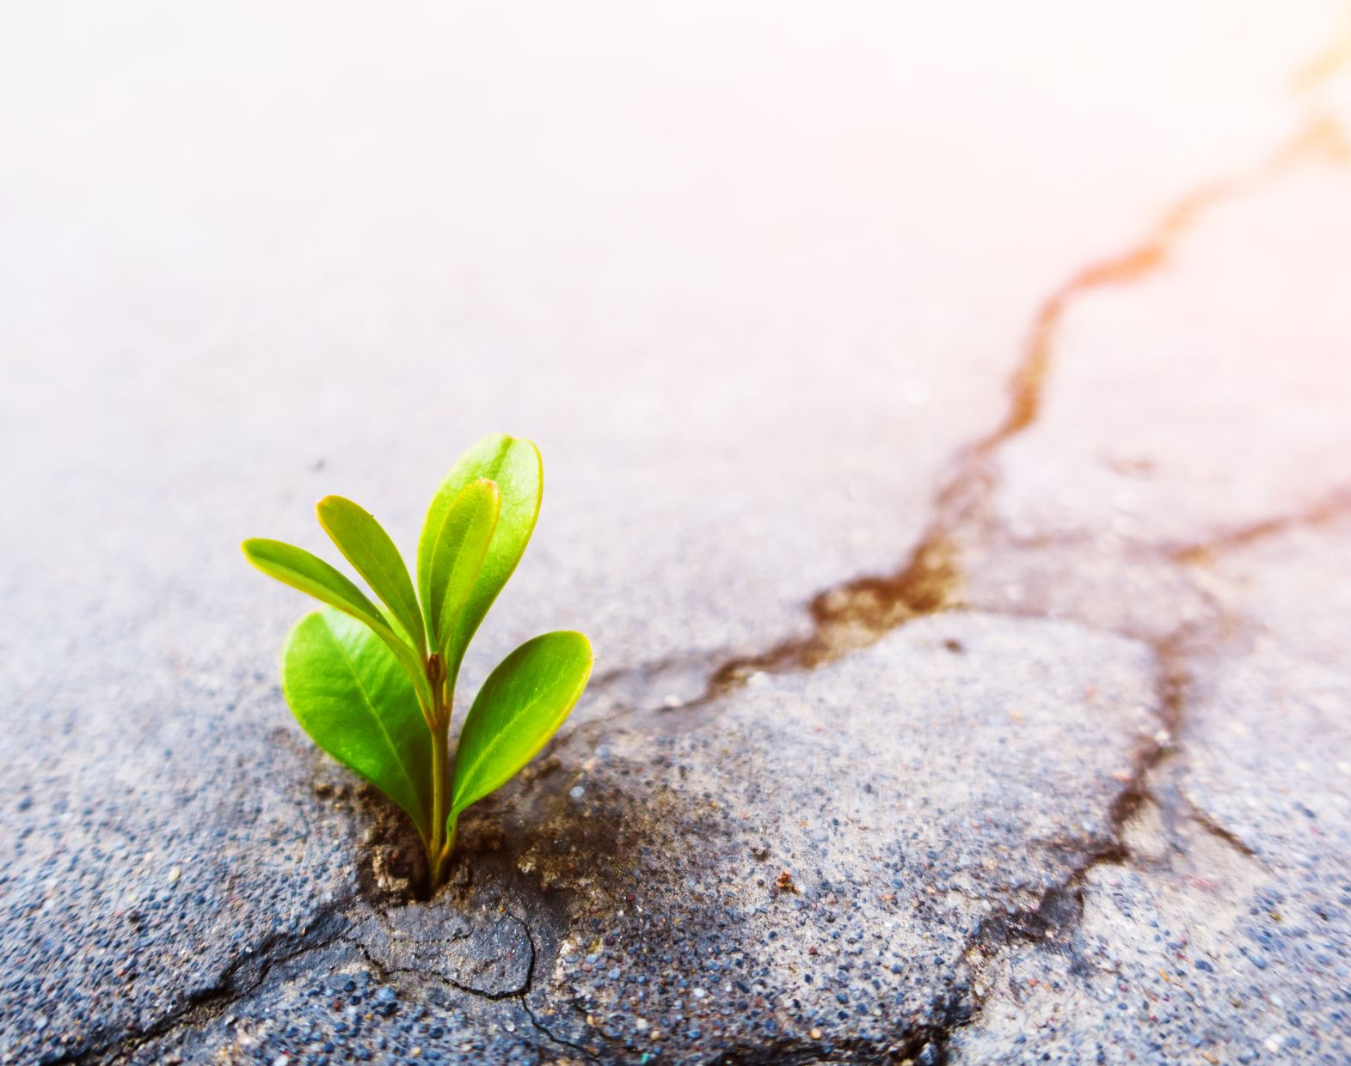
Why this project?
My educational background is in biology and environmental science. I’ve done scientific research on sustainable agriculture, conservation physiology, and biodiversity. Which are just a fraction of fields that are included under the umbrella of conservation and sustainability.
For a long time, I’ve been passionate about protecting our planet, which includes ways to reduce anthropogenic impact on the environment.

Slide 3

The impact of traveling and tourism?
I wanted to combine my love for the environment with my love of traveling. However, traveling does have its setbacks.
Air and car travel for example, contribute large amounts of CO2 emissions.
Over-tourism is a very real phenomenon that can negatively affect attractions and communities.

Slide 4
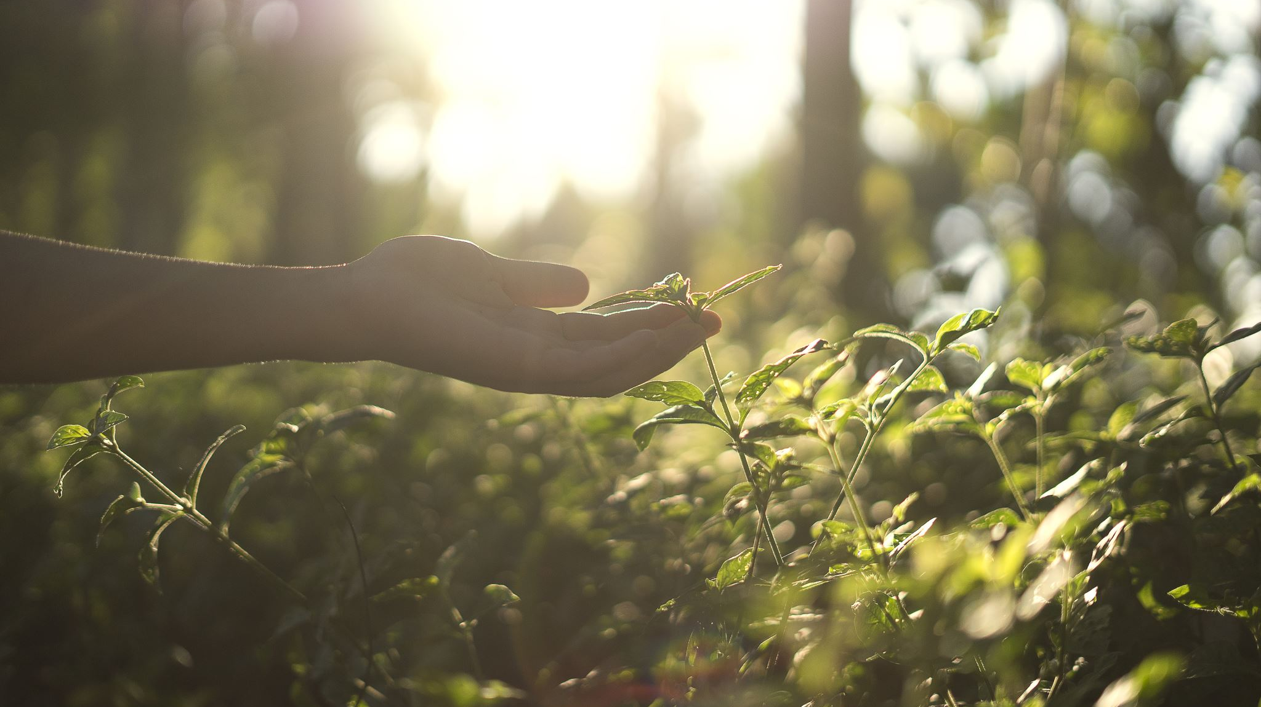

Preferences, are you seeking a more rural or urban vacation?
Different environmental attributes are measured and weighted depending on whether you are looking for a more rural or urban vacation.
These statistical values are courtesy of NASA’s extensive environmental database.

Slide 5

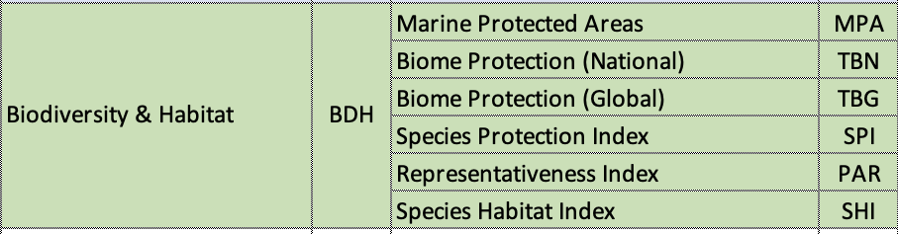
Rural-eco Rating
Source: NASA EPI index
*BDH: Biodiversity & Habitat. This number encapsulates a country’s biodiversity and their protection efforts when it comes to their habitats and wellbeing.
*CCE: Climate & Energy. This number focuses on carbon and other greenhouse gas emissions that come from both energy production and consumption.

Slide 6
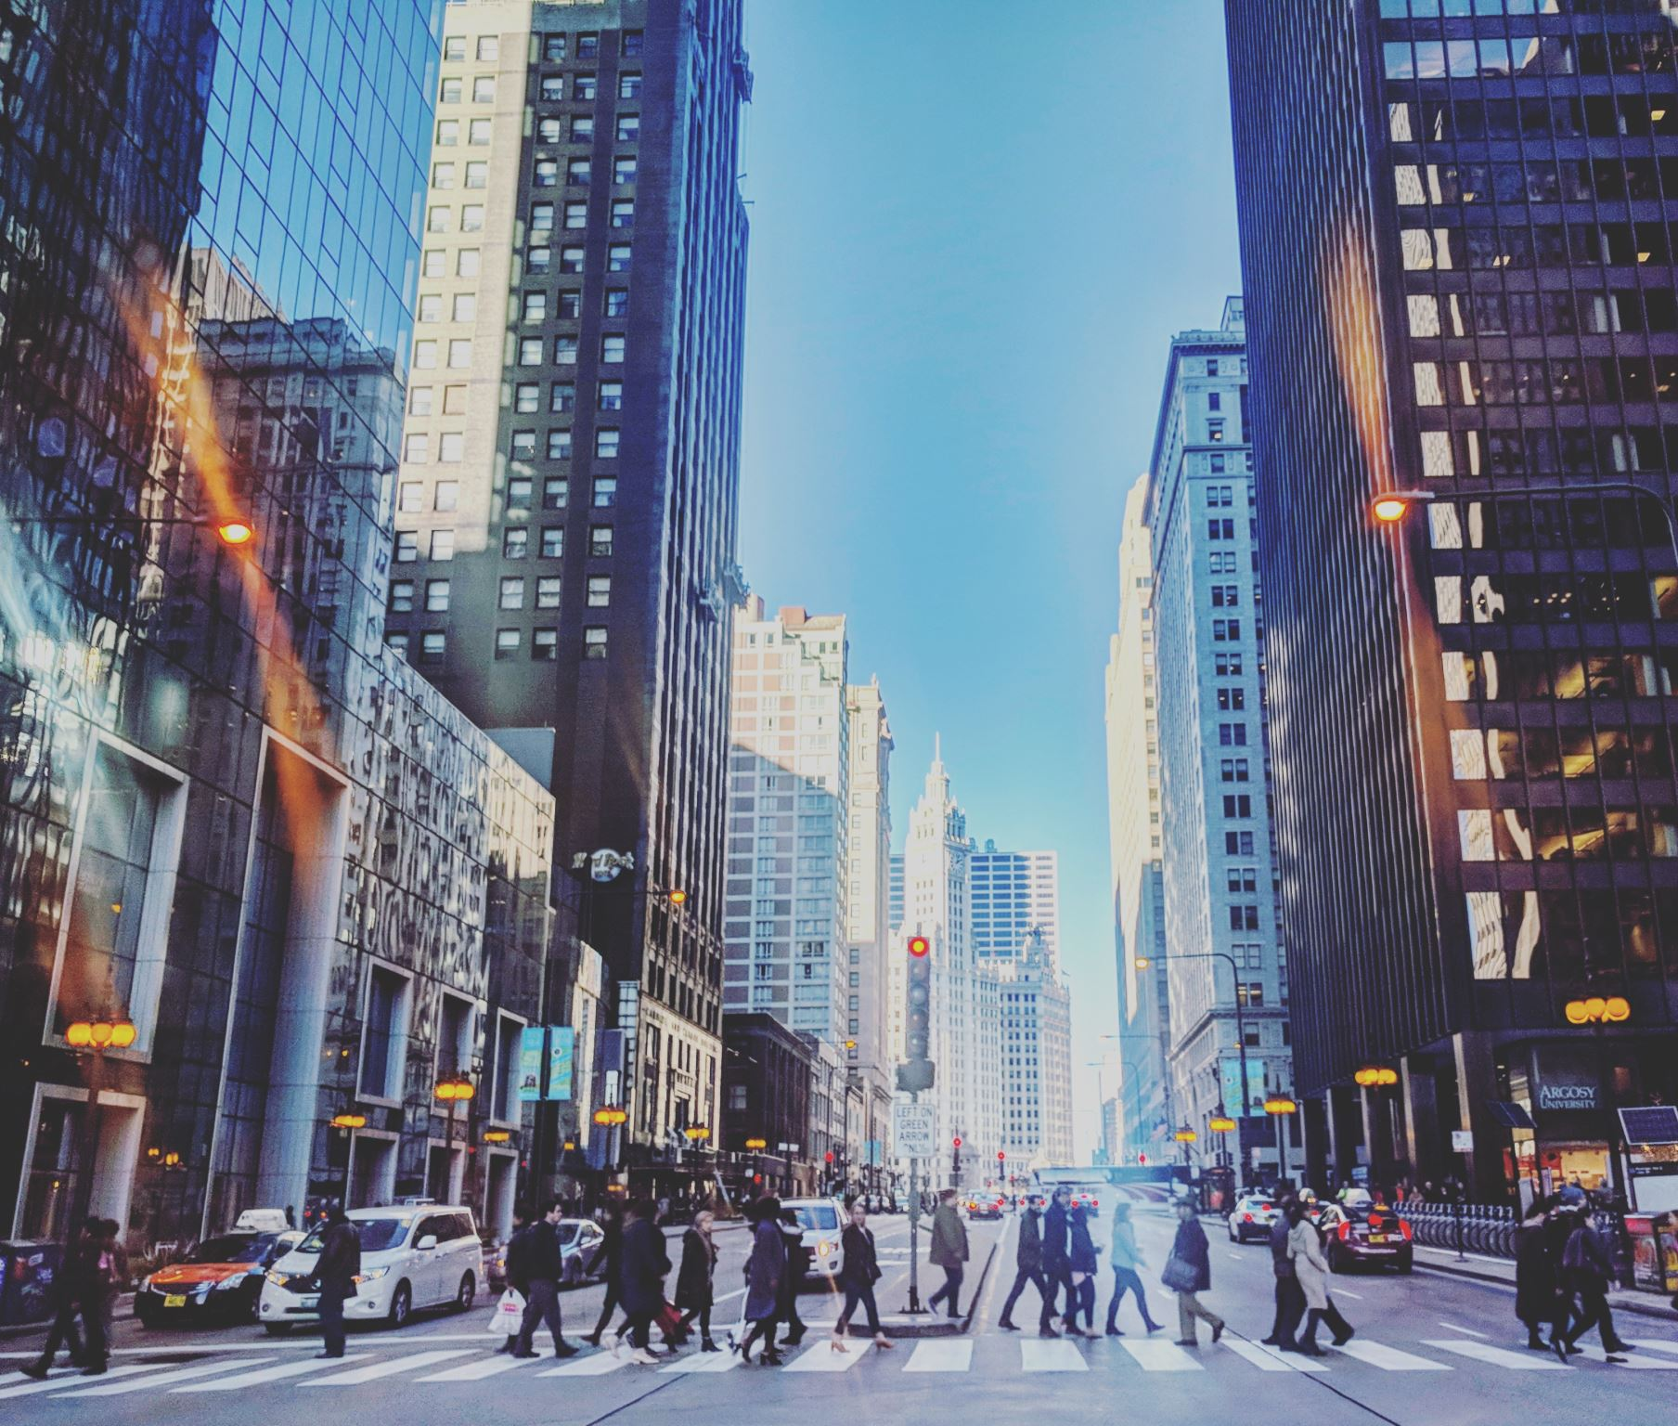
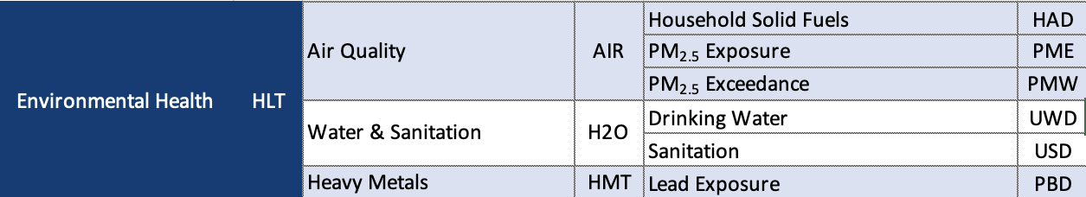
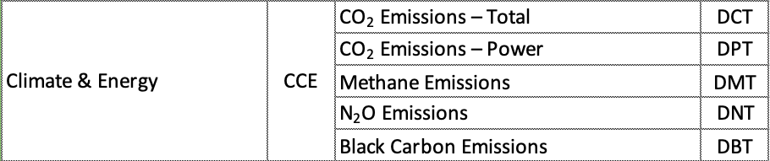
Urban-eco Rating
*HLT: Environmental Health. This number is more overarching, containing data from more measurements.
*CCE: Climate & Energy. This number focuses on carbon and other greenhouse gas emissions that come from both energy production and consumption.
Source: NASA EPI index

Slide 7
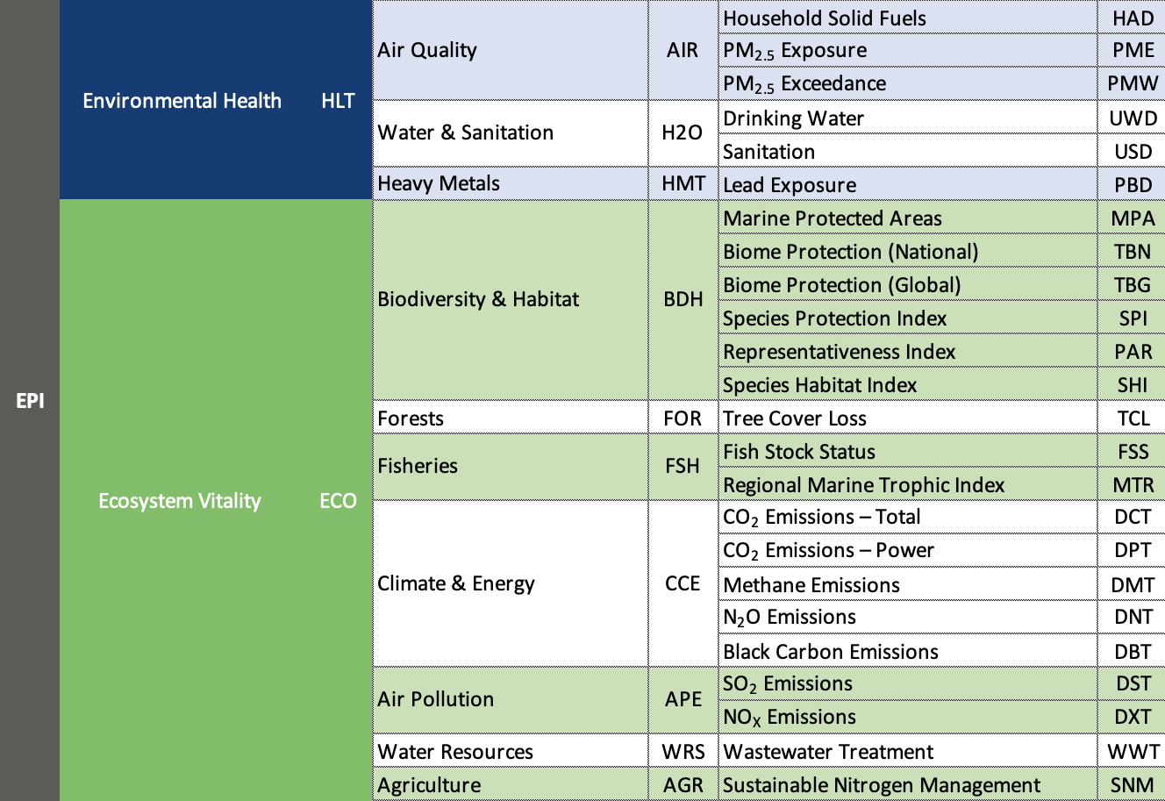
EPI rating
A country’s EPI are all the following attributes combined. Providing a comprehensive number that gives an insight into a country’s overall environmental impact.
Source: NASA EPI index

Slide 8


Thanks to the organizations and institutions that made this project possible!

